Slide 1
Hand-Washing Smart-Watch
ECE 212-Summer 2020
Team 4: Gabrielle, Jana, Zheng, Garth

Slide 2
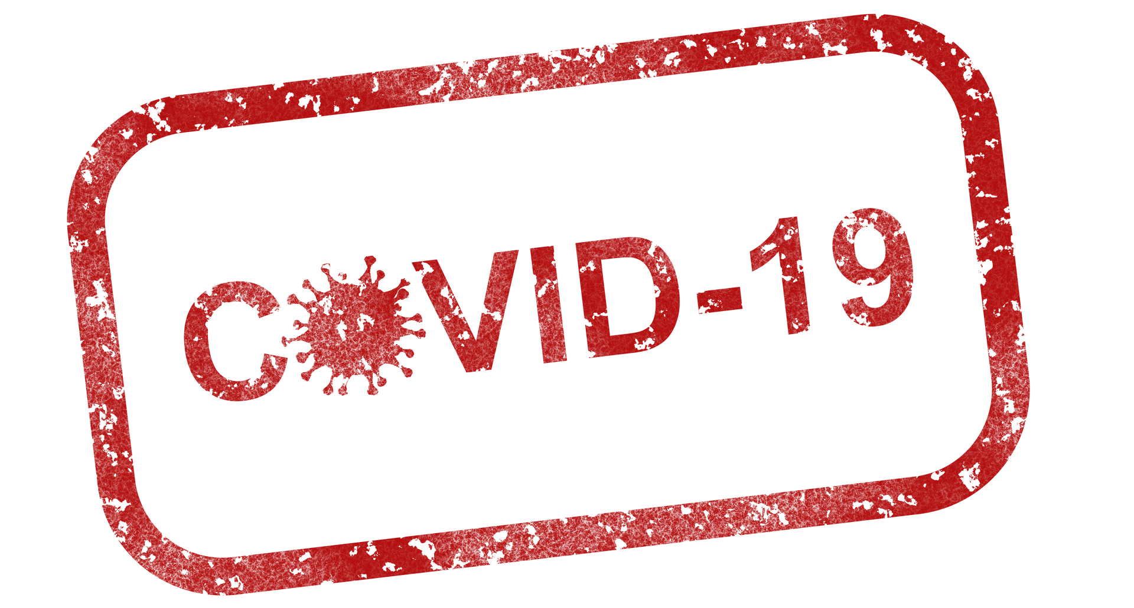
Problem
Notes:
Jana
In light of the current pandemic, the CDC has made multiple recommendations such as wearing a face mask, keeping 6 feet apart, and to regularly wash one’s hands for 30 seconds. With this in mind,we asked ourselves how could someone do this accurately other than singing happy birthday 3 times?

Slide 3

Solution
Hand washing reminder watch with the following features:
12/24 hour time display
Notification system to remind user when to wash hands
Timer for washing hands
Collect and transmit data via bluetooth
Notes:
Jana
having a watch with the hand-washing feature is a great way to create and maintain health and hygiene habits such as washing your hands when possible.
This watch is to help keep up good hygiene practices as well as act as a normal watch, that is able to transmit data to another device.

Slide 4
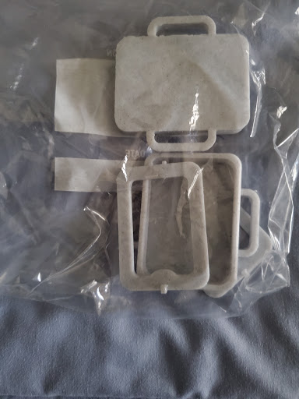
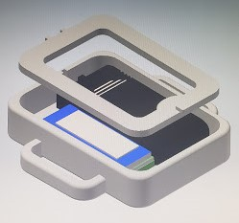
Enclosure & 3D model
Notes:
Gabrielle
After doing research on our project and how we were going to approach it, we made a Bill of materials listing all the components needed for the job. Once we did that, I created a 3D model in Inventor with the accurate dimensions of each component, then created the enclosure case of the watch. The bottom portion has the loop holes for a watch band and the top portion is open in the center for a plastic screen to get placed in so it acts as a screen. We then got this 3D printed as you can see in the picture on the left

Slide 5
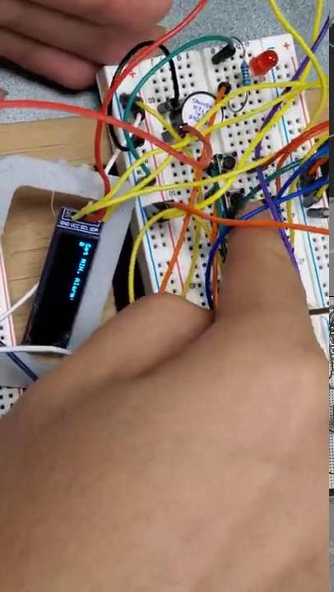
24-Hour Function
& alarm with button control
Notes:
for the project, First we finished the function of 24 hour clock. The feature of 24 hour display is we add a real time clock module which make sure when the power cut off, the time will not be reset.And can be automatically corrected to the current time. And we also add the function of alarm to remind people washing their hands.

Slide 6
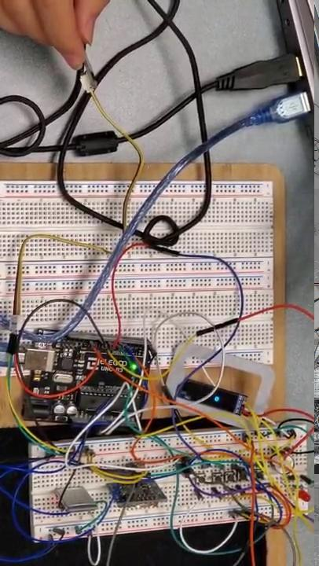
Countdown Timer/
Vibration Sensor
Notes:
Zhang

Slide 7

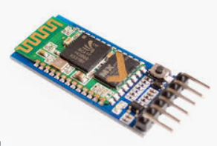
Phone App -
Bluetooth System
Notes:
Gabrielle
Here you can see the app made in MIT App Inventor. This app was created to connect a phone to the watch via bluetooth, and be able to send notifications through. Originally we wanted to be able to collect the hand washing data from the watch and have it display on the phone app, but with the time crunch and some parts not working by specific deadlines, this made it a stretch goal instead of a requirement for this project. This video shows the phone being connected to the watch

Slide 8
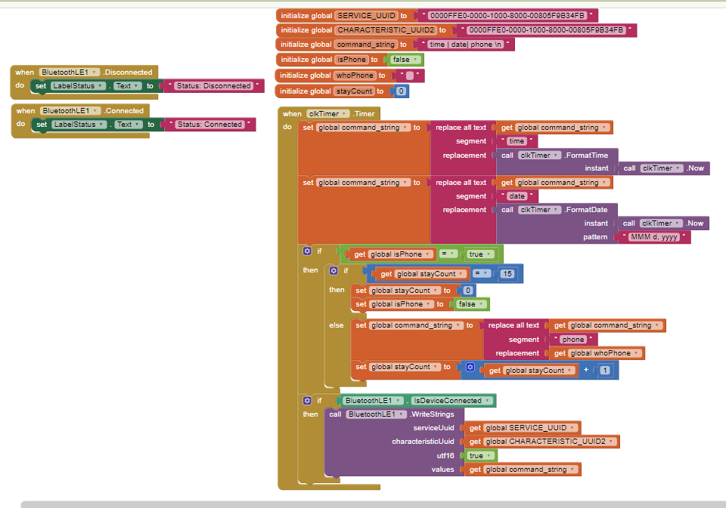
Phone App -
Notification
System
Notes:
Gabrielle
The app I made was meant to accomplish two things: connect to bluetooth and send some sort of notification. With the time crunch, I instead made the app work so that when an android device receives an incoming phone call, it would display on the watch that there was an incoming phone call. In theory this was supposed to work, but with the time crunch, this function didn’t work as expected. I think if we had more time, I would have been able to debug the app and would have made for a really cool feature on this smart-watch.

Slide 9
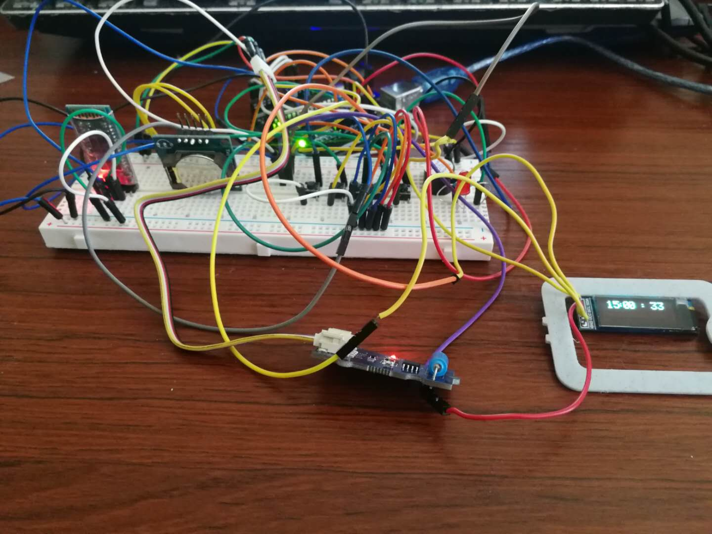
Prototype
Our Hand-Washing Smartwatch prototype.
Notes:
Garth

Slide 10
Conclusion
The hand washer reminder prototype was made using an Arduino Uno with a grove - vibration sensor with a smart device app.
Whenever a person washes his/her hands after the set alarm goes off, the vibration sensor detects hand washing gestures and triggers the reset of the Arduino board for 20 seconds.
It was designed to run on smart devices to provide reminders and automatically keep track of each hand wash data via bluetooth.
Regular hand washing is widely recognized as the most effective means to combat the spread of infectious illness/ viruses such as COVID-19. We as a team thinks it is a highly scalable project and overcomes most limitations for an individual.
Notes:
Garth

Slide 11
Questions
Notes:
Garth

